Slide 1


Jacob Martin
14 January 2025

Slide 2

Outline
Executive Summary
Introduction
Methodology
Results
Conclusion
Appendix

Slide 3
Executive Summary - Methodologies
Data Collection:
Retrieved initial rocket launch data via SpaceX API, with supplementary launch details from web scraping the "List of Falcon 9 and Falcon Heavy launches" Wikipedia page (updated June 9, 2021).
Data Preprocessing:
Replaced missing values with column means (except for Landing Pad data left as NaN).
Filtered results to include only Falcon 9 launches.
Exploratory Data Analysis (EDA):
Examined relationships between Flight Number, Payload Mass, launch sites, orbit types, and landing outcomes.
Machine Learning:
Standardized key features and used Grid Search Cross Validation with four models: Logistic Regression, Support Vector Machines, Decision Tree, and k-Nearest Neighbors.

Slide 4
Executive Summary - Results
Key EDA Insights:
Higher Flight Numbers correlate with greater landing success rates.
VAFB SLC 4E and KSC LC 39A sites have higher success rates compared to CCAFS SLC 40.
Orbit types ES-L1, GEO, HEO, and SSO achieved 100% success rates.
Success rate plateaued around 85% since 2020.
Model Performance:
Logistic Regression, Support Vector Machines, and k-Nearest Neighbors achieved similar test accuracies.
Best performing model: Logistic Regression (83.33% accuracy).
Worst performing model: Decision Tree (77.78% accuracy).

Slide 5
Introduction
SpaceX advertises Falcon 9 rocket launches on its website with a cost of $62 million; other providers cost upward of $165 million each, much of the savings is because SpaceX can reuse the first stage.
Therefore if we can determine if the first stage will land, we can determine the cost of a launch. This information can be used if an alternate company wants to bid against SpaceX for a rocket launch.

Slide 6

Section 1

Slide 7
Data Collection - SpaceX API
The process begins by making an API call to the SpaceX API to request initial rocket launch data. Next, the launch IDs obtained from the initial API call are extracted for further use. Separate API calls are made using the previously extracted launch IDs to get detailed information about each launch. The results are then filtered to only include those pertaining to the Falcon 9 rocket model.
All missing (NaN) values are replaced with the mean of that column, except for the missing values related to the Landing Pad which are left as NaN.

Slide 8
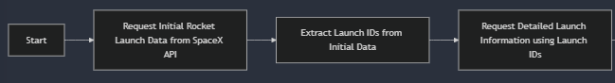
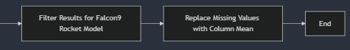
Data Collection – SpaceX API
https://github.com/jacobmartin26/IBM-Data-Science/blob/main/Capstone/Lab%201%20Collecting%20the%20data.ipynb

Slide 9
Data Collection - Scraping
Webpage Selection:
A snapshot of the "List of Falcon 9 and Falcon Heavy launches" Wikipedia page (updated on June 9, 2021) was used as the data source.
Target Table Identification:
The third HTML table on the page was identified as containing the relevant launch records.
Column Name Extraction:
Extracted all column/variable names by iterating through the <th> elements in the table header using the extract_column_from_header() function.
Row Parsing:
Parsed each row of the HTML table to extract launch records.
Data Frame Creation:
Populated a dictionary (launch_dict) with the extracted records and transformed it into a structured DataFrame for analysis.

Slide 10
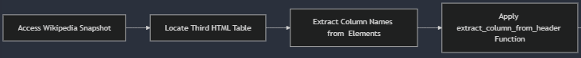
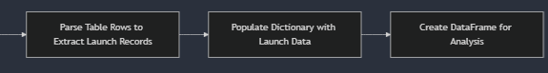
Data Collection - Scraping
https://github.com/jacobmartin26/IBM-Data-Science/blob/main/Capstone/Lab%201.5%20Web%20scraping%20Falcon%209%20and%20Falcon%20Heavy%20Launches%20Records%20from%20Wikipedia.ipynb

Slide 11
Data Wrangling
Missing Values Analysis:
Identified and calculated the percentage of missing values in each attribute.
Data Type Identification:
Classified attributes into numerical and categorical columns for further processing.
Launch Site Analysis:
CCAFS SLC 40: 55 launches
KSC LC 39A: 22 launches
VAFB SLC 4E: 13 launches
Orbit Analysis:
GTO: 27 missions
ISS: 21 missions
VLEO: 14 missions
Other orbit types had smaller frequencies, such as PO (9) and LEO (7).
Created a binary Landing Outcome Label based on the Outcome column:
Value 0 for bad outcomes where the first stage did not land successfully.
Value 1 for successful outcomes where the first stage landed successfully.

Slide 12
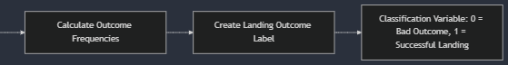
Data Collection - Scraping
https://github.com/jacobmartin26/IBM-Data-Science/blob/main/Capstone/Lab%202%20Data%20Wrangling.ipynb

Slide 13
EDA with Data Visualization
The first relationship examined was how flight number and payload mass contribute to landing success rates. A scatterplot was used to easily show the correlation between the two features and our target variable. Scatterplots were also used to show the relationships between flight number vs launch site, payload mass vs launch site, flight number vs orbit type, and payload mass vs orbit type.
A bar graph was used to show the success rates by each distinct orbit type.
Lastly, a line graph was used to show how the overall success rate of launches changed year over year
https://github.com/jacobmartin26/IBM-Data-Science/blob/main/Capstone/Lab%203.5%20EDA%20with%20Visualization%20Lab.ipynb

Slide 14
EDA with SQL
Converted .csv file into sqlite database file
Displayed the names of the unique launch sites in the space mission
Displayed 5 records where launch sites begin with the string 'CCA'
Displayed the total payload mass carried by boosters launched by NASA (CRS)
Displayed average payload mass carried by booster version F9 v1.1
Listed the date when the first successful landing outcome in ground pad was achieved.
Listed the names of the boosters which have success in drone ship and have payload mass greater than 4000 but less than 6000
Listed the total number of successful and failure mission outcomes
Listed the names of the booster versions which have carried the maximum payload mass
Listed the records which will display the month names, failure landing_outcomes in drone ship, booster versions, launch_site for the months in year 2015.
Ranked the count of landing outcomes (such as Failure (drone ship) or Success (ground pad)) between the date 2010-06-04 and 2017-03-20, in descending order.
https://github.com/jacobmartin26/IBM-Data-Science/blob/main/Capstone/Lab%203%20EDA%20with%20SQL.ipynb

Slide 15
Build an Interactive Map with Folium
Added a Folium circle and marker to each launch site on the site map in order to mark and label where each launch site is located in the US.
Added a marker cluster that holds markers of both successful and failed launches for each unique launch site on the map. Successful launches are green while failed ones are red. This makes it quicker to see which sites are more popular and/or more successful with its launches.
Added a line between the CCAFS SLC-40 launch site and its nearest coastline, highway, railway, and city in order to see if launch sites were in close proximity to certain structures.
https://github.com/jacobmartin26/IBM-Data-Science/blob/main/Capstone/Lab%204%20Visual%20Analytics%20with%20Folium.ipynb

Slide 16
Build a Dashboard with Plotly Dash
Added a dropdown list with all unique launch sites to enable launch site selection, defaults to all sites. The selected site will then change the data displayed in a pie chart that was added which will show the Success vs. Failed counts for the site. If all sites are selected then it will instead show the total amount of successful launches for all sites.
Added a slider to select a payload range (0 to 10000kg) for launches. This slider will update a scatter plot that was also added which shows the correlation between payload mass and launch success based on the selected launch site from the dropdown list.
Overall, these features should make it quick and easy for the user to view key features for all launch sites or a single launch site.
https://github.com/jacobmartin26/IBM-Data-Science/blob/main/Capstone/Lab%204.5%20Interactive%20Dashboard%20with%20Ploty%20Dash.py

Slide 17
Predictive Analysis (Classification)
Feature Standardization:
Applied a Standard Scaler to standardize features assigned to X for consistency in model performance.
Data Splitting:
Divided the dataset into training and testing subsets to evaluate model performance effectively.
Model Selection and Evaluation:
Evaluated 4 classification models:
Logistic Regression
Support Vector Machines (SVM)
Decision Trees
K-Nearest Neighbors (KNN)
Grid Search Cross Validation (CV):
Used Grid Search CV with a 10-fold cross-validation to optimize hyperparameters for all models and maximize accuracy.

Slide 18
Predictive Analysis (Classification) Continued
Hyperparameter Tuning:
Logistic Regression: Tuned C, penalty, and solver parameters.
SVM: Tuned kernel, C, and gamma parameters.
Decision Trees: Tuned criterion, splitter, max_depth, and other parameters.
KNN: Tuned n_neighbors, algorithm, and p parameters.
Best-Performing Model:
Logistic Regression was the best-performing model with a test accuracy of 83.33%.
Decision Trees performed the worst with an accuracy of 77.78%.

Slide 19
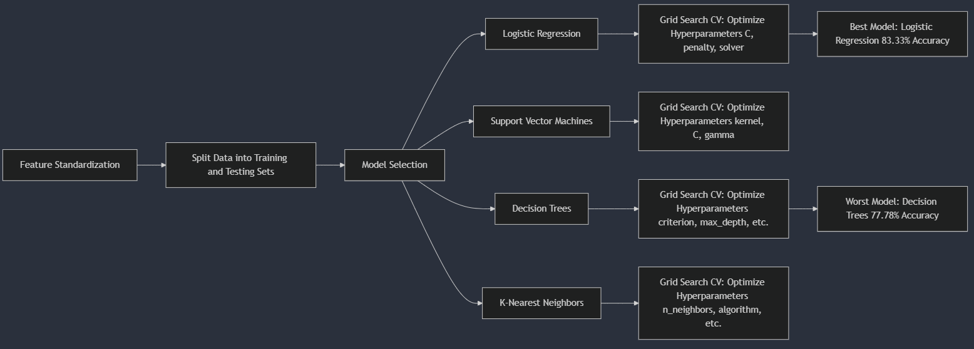
Predictive Analysis (Classification) Continued
https://github.com/jacobmartin26/IBM-Data-Science/blob/main/Capstone/Lab%205%20Machine%20Learning%20Prediction.ipynb

Slide 20

Section 2

Slide 21
Flight Number vs. Launch Site
Show a scatter plot of Flight Number vs. Launch Site
Show the screenshot of the scatter plot with explanations

Slide 22
Payload vs. Launch Site
Show a scatter plot of Payload vs. Launch Site
Show the screenshot of the scatter plot with explanations

Slide 23
Success Rate vs. Orbit Type
Show a bar chart for the success rate of each orbit type
Show the screenshot of the scatter plot with explanations

Slide 24
Flight Number vs. Orbit Type
Show a scatter point of Flight number vs. Orbit type
Show the screenshot of the scatter plot with explanations

Slide 25
Payload vs. Orbit Type
Show a scatter point of payload vs. orbit type
Show the screenshot of the scatter plot with explanations

Slide 26
Launch Success Yearly Trend
Show a line chart of yearly average success rate
Show the screenshot of the scatter plot with explanations

Slide 27
All Launch Site Names
Find the names of the unique launch sites
Present your query result with a short explanation here

Slide 28
Launch Site Names Begin with 'CCA'
Find 5 records where launch sites begin with `CCA`
Present your query result with a short explanation here

Slide 29
Total Payload Mass
Calculate the total payload carried by boosters from NASA
Present your query result with a short explanation here

Slide 30
Average Payload Mass by F9 v1.1
Calculate the average payload mass carried by booster version F9 v1.1
Present your query result with a short explanation here

Slide 31
First Successful Ground Landing Date
Find the dates of the first successful landing outcome on ground pad
Present your query result with a short explanation here

Slide 32
Successful Drone Ship Landing with Payload between 4000 and 6000
List the names of boosters which have successfully landed on drone ship and had payload mass greater than 4000 but less than 6000
Present your query result with a short explanation here

Slide 33
Total Number of Successful and Failure Mission Outcomes
Calculate the total number of successful and failure mission outcomes
Present your query result with a short explanation here

Slide 34
Boosters Carried Maximum Payload
List the names of the booster which have carried the maximum payload mass
Present your query result with a short explanation here

Slide 35
2015 Launch Records
List the failed landing_outcomes in drone ship, their booster versions, and launch site names for in year 2015
Present your query result with a short explanation here

Slide 36
Rank Landing Outcomes Between 2010-06-04 and 2017-03-20
Rank the count of landing outcomes (such as Failure (drone ship) or Success (ground pad)) between the date 2010-06-04 and 2017-03-20, in descending order
Present your query result with a short explanation here

Slide 37

Section 3

Slide 38
<Folium Map Screenshot 1>
Replace <Folium map screenshot 1> title with an appropriate title
Explore the generated folium map and make a proper screenshot to include all launch sites’ location markers on a global map
Explain the important elements and findings on the screenshot

Slide 39
<Folium Map Screenshot 2>
Replace <Folium map screenshot 2> title with an appropriate title
Explore the folium map and make a proper screenshot to show the color-labeled launch outcomes on the map
Explain the important elements and findings on the screenshot

Slide 40
<Folium Map Screenshot 3>
Replace <Folium map screenshot 3> title with an appropriate title
Explore the generated folium map and show the screenshot of a selected launch site to its proximities such as railway, highway, coastline, with distance calculated and displayed
Explain the important elements and findings on the screenshot

Slide 41

Section 4

Slide 42
<Dashboard Screenshot 1>
Replace <Dashboard screenshot 1> title with an appropriate title
Show the screenshot of launch success count for all sites, in a piechart
Explain the important elements and findings on the screenshot

Slide 43
<Dashboard Screenshot 2>
Replace <Dashboard screenshot 2> title with an appropriate title
Show the screenshot of the piechart for the launch site with highest launch success ratio
Explain the important elements and findings on the screenshot

Slide 44
<Dashboard Screenshot 3>
Replace <Dashboard screenshot 3> title with an appropriate title
Show screenshots of Payload vs. Launch Outcome scatter plot for all sites, with different payload selected in the range slider
Explain the important elements and findings on the screenshot, such as which payload range or booster version have the largest success rate, etc.

Slide 45

Section 5

Slide 46
Classification Accuracy
Visualize the built model accuracy for all built classification models, in a bar chart
Find which model has the highest classification accuracy

Slide 47
Confusion Matrix
Show the confusion matrix of the best performing model with an explanation

Slide 48
Conclusions
Point 1
Point 2
Point 3
Point 4
…

Slide 49
Appendix
Include any relevant assets like Python code snippets, SQL queries, charts, Notebook outputs, or data sets that you may have created during this project

Slide 50


